Slide 1

sonarwhal
The linting tool for the web
Huy Dao
Daniel Bravo
Nellie the narwhal
Notes:
Hello everyone we are Huy Dao and Daniel Bravo and today we’re going to be talking about sonarwhal, described by some as a linter for the web.

Slide 2

linter
/ˈlɪntə/
tools that analyze source code to flag programming errors, bugs, stylistic errors, and suspicious constructs.
Notes:
So what is linting. Initially, it was used to describe the process of removing unwanted fibers and fluffs. In the developer world it has been redefined to describe the process of analyzing code. Usually, this includes flagging various types of programming and stylic errors.

Slide 3
sonarwhal
6 categories, 30 rules
Integrate other tools and services
npm install -g --engine-strict sonarwhal
Notes:
Sonarwhal is an open-source linting tool that analyzes a web site or application. It analyzes things like accessibility and content types, and verifies that your JS libraries don’t include known vulnerabilities. Currently, it check overs 30 rules in 6 different categories. Some of the categories include Interoperability, Performance and Security. Sonarwhal it great because it checks things that developers often don’t pay too much attention to. In addition, its philosophy is not to reinvent the wheel. Instead it packages already existing tools into one linter. It also is very flexible and customizable. For example, new rules can be created or certain rules can be disabled for a particular project. Version 1 was released recently and includes a cli client that will check your code and config files for you. To use the cli version used npm to install it.

Slide 4
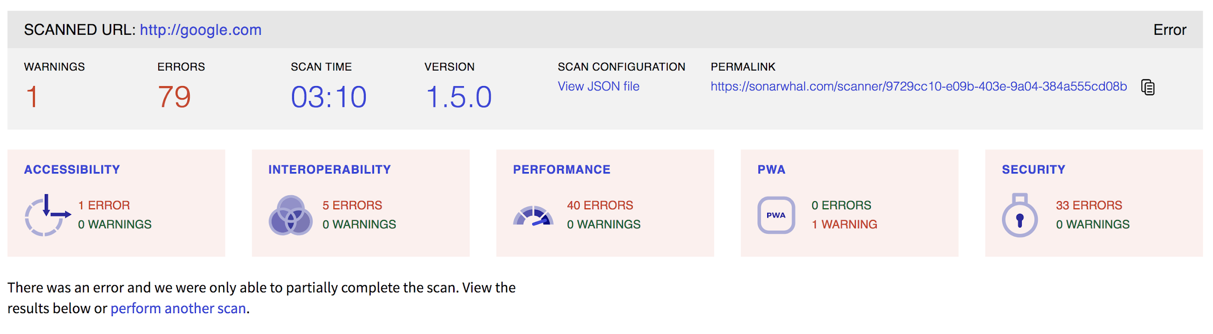
sonarwhal online
https://sonarwhal.com/scanner (in preview)
Notes:
Sonarwhal also supports an online service to run a scan. Currently the service is in preview and has predetermined rules that it checks. However, there is a vision to expand it to be as flexible as the cli version. You can analyze any website but following the link above and entering the URL to the website. Additionally, you can run the service from the command line. You get a report the this one [point to screen] with details about the errors it found. It also includes specific details about the rules that were violated.

Slide 5
Why sonarwhal?
Rules are customizable :
Disable or enable existing rule that suit your need
Creating the rule:
+ Installing new rule from global package or writing
it by yourself
Nellie the narwhal

Slide 6
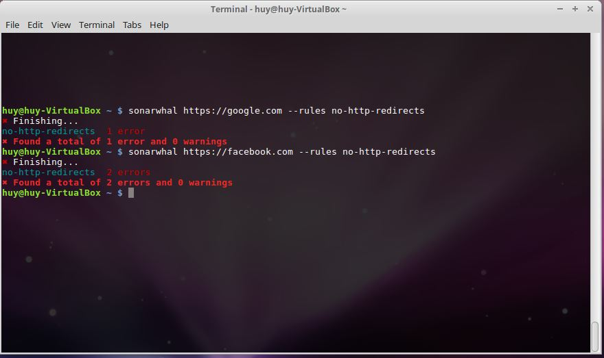
Example
-No http redirect rule: It will check if the website URL and it’s resource have any redirect to other site. This rule is helpful since redirect process may slow down the performance of loading the website.
-How to install:
-Testing:
npm install @sonarwhal/rule-no-http-redirects

Slide 7
Source
https://sonarwhal.com/
https://github.com/sonarwhal/sonarwhal
https://blogs.windows.com/msedgedev/2018/04/19/sonarwhal-v1-linting-tool-for-web/#kcYFgIoXWOcRPL0X.97
Nellie the narwhal

